Slide 1

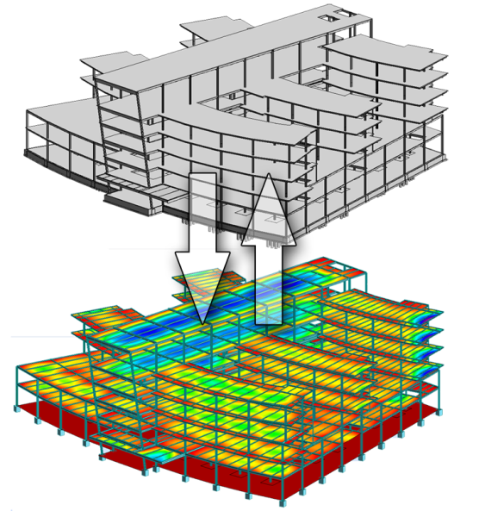
Structural Analysis I
Chapter 1
Types of Structures & Loads
Saad M Raouf, Ph.D.
Civil Engineering Department
dr.saadraouf@tu.edu.iq

Slide 2

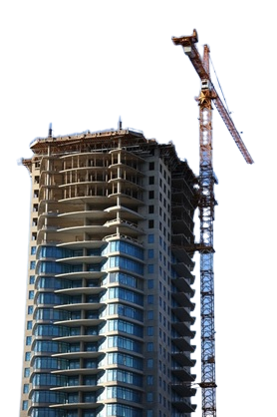


Introduction
Structure refers to a system of connected parts used to support load, such as Buildings, Bridges, Towers, Stadiums, ……………. etc.

Slide 3
Topics to Be Addressed
Overview of structures: Definition and examples.
Types of structural elements (e.g., beams, columns, trusses).
Categories of loads (dead loads, live loads, wind loads, etc.).
Structural analysis methods and their applications.
Introduction to structural design considerations.

Slide 4
Objectives
Introduce the fundamentals of structural analysis and its significance in engineering design.
Understand various types of structures and their components.
Identify different types of loads and their effects on structures.
Develop a systematic approach to analyzing forces and moments in structural elements.

Slide 5
Introduction
Structural Analysis involves the prediction of the performance of a given structure under prescribed loads and/or other external effects, such as support movements and temperature changes.
The fundamental purpose of a structural analysis is to determine the magnitudes of force/moment and displacement for each element of a design system for a given set of design loads.

Slide 6
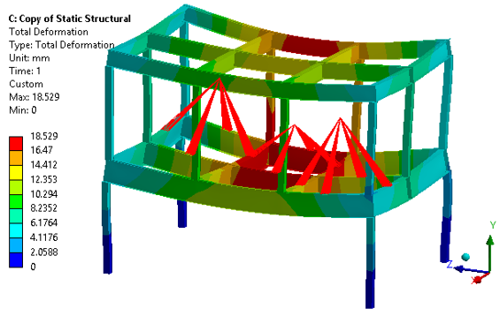
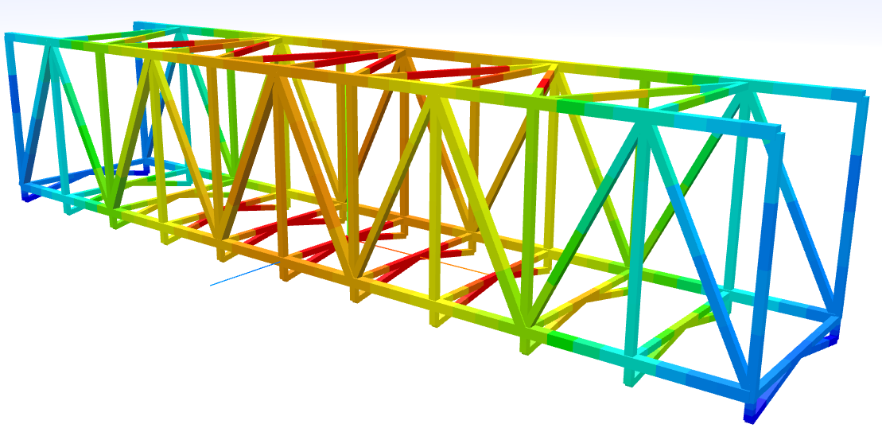
Introduction

Slide 7
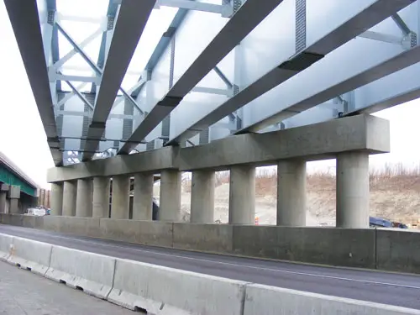
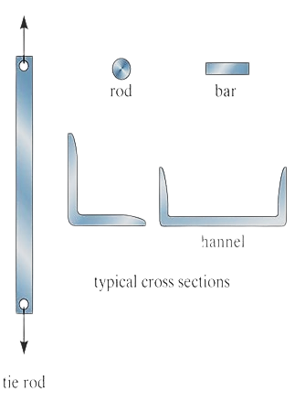

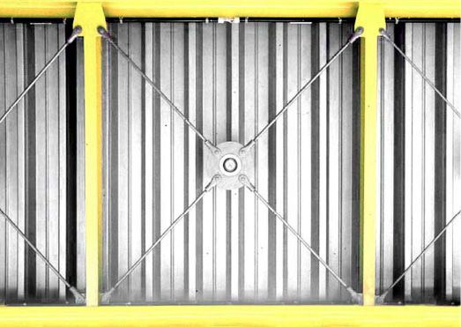
Structural Elements
Tie Rods

Slide 8

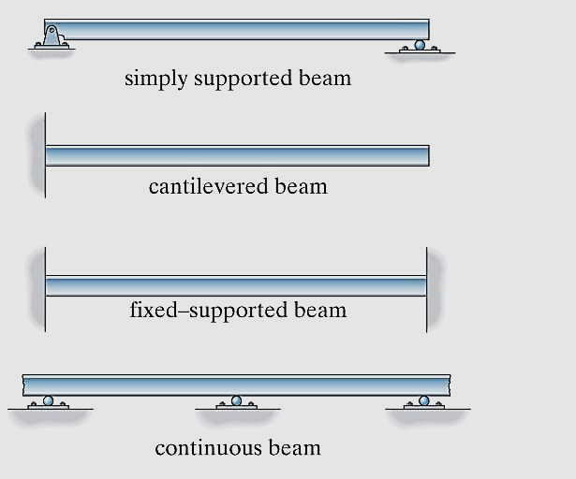
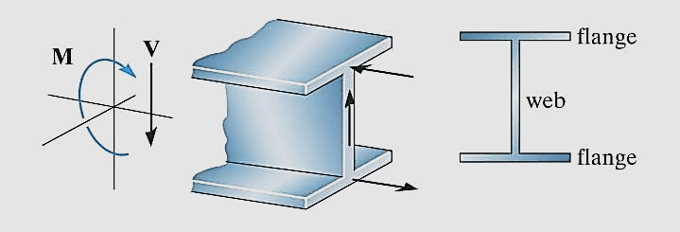
Beams
Structural Elements
Type of Beams

Slide 9
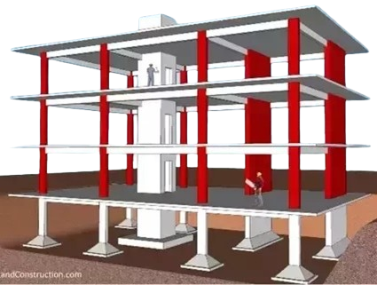
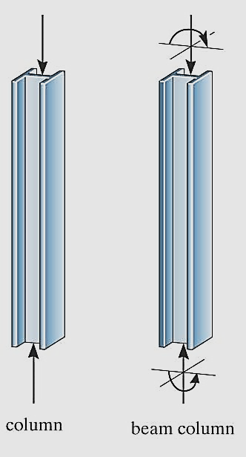
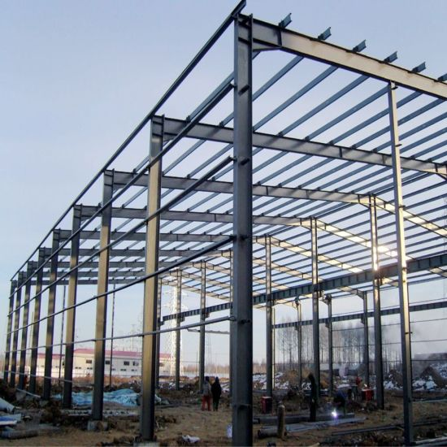
Structural Elements
Columns

Slide 10
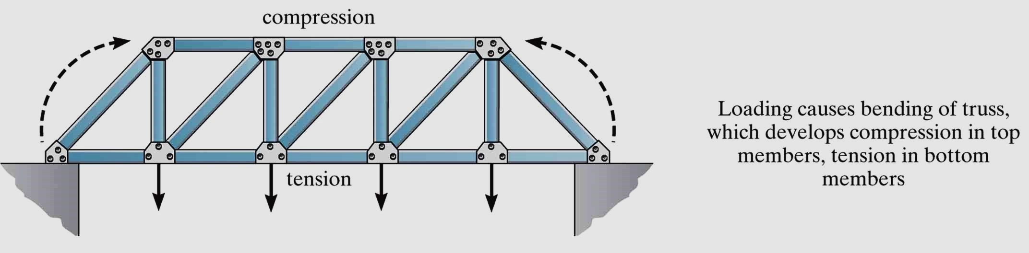
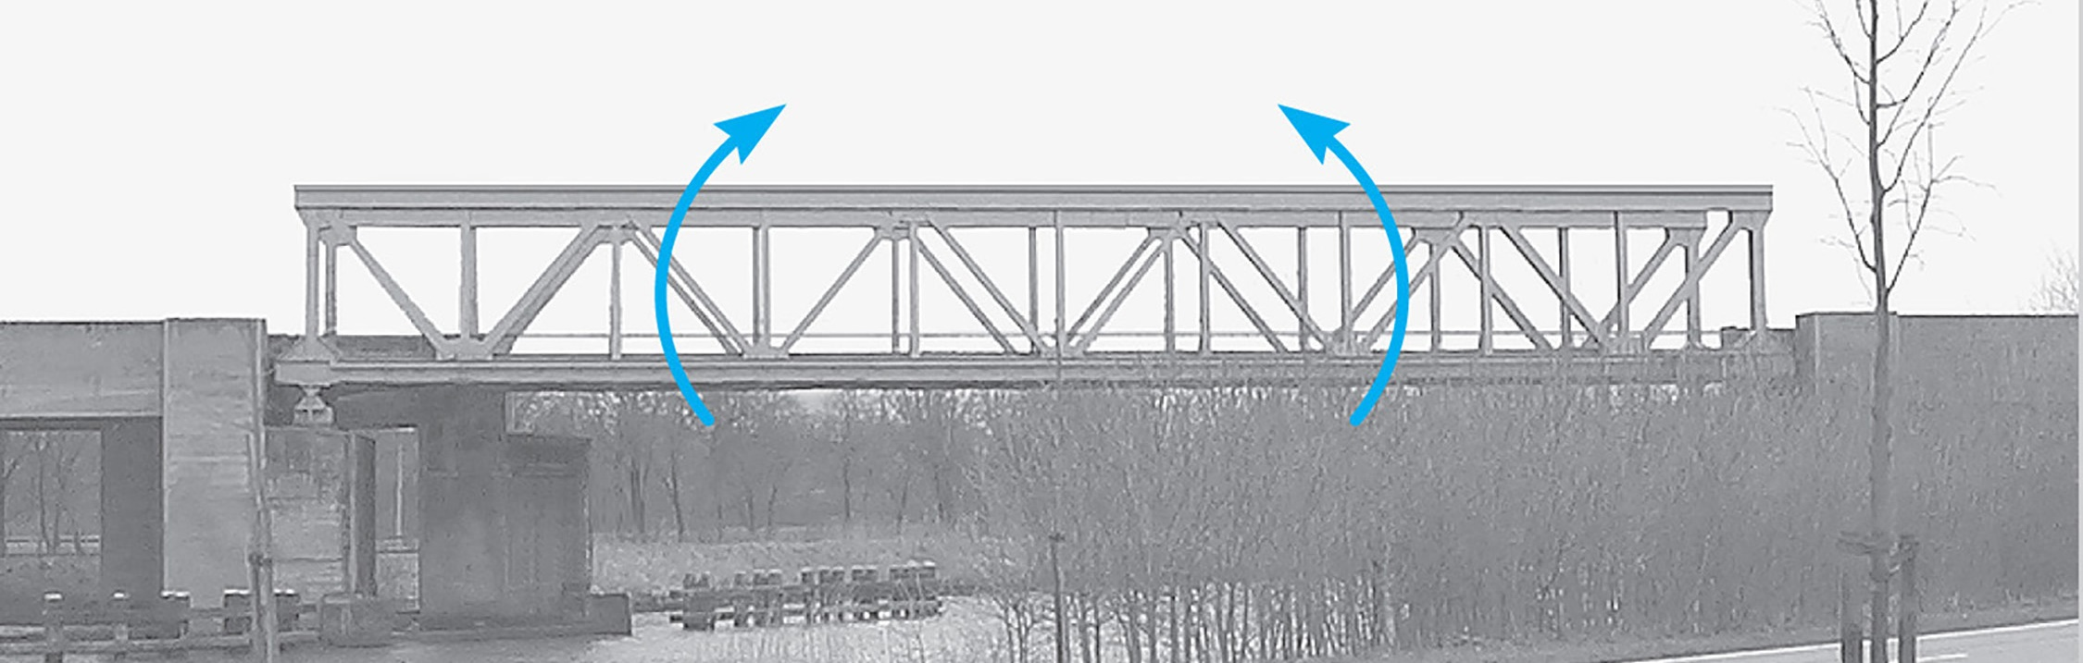
Types of Structures
Trusses

Slide 11
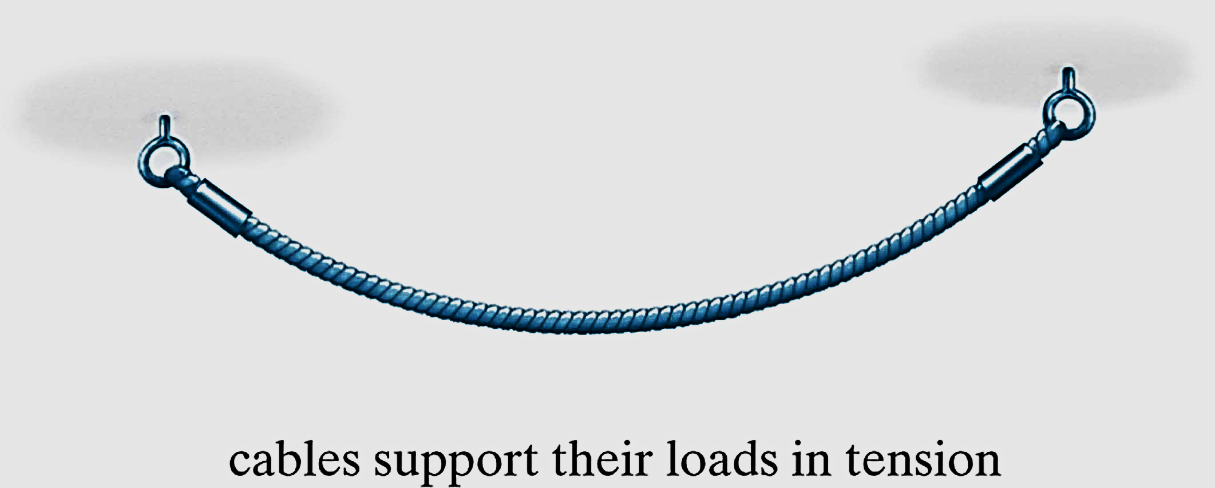


Types of Structures
Cables

Slide 12
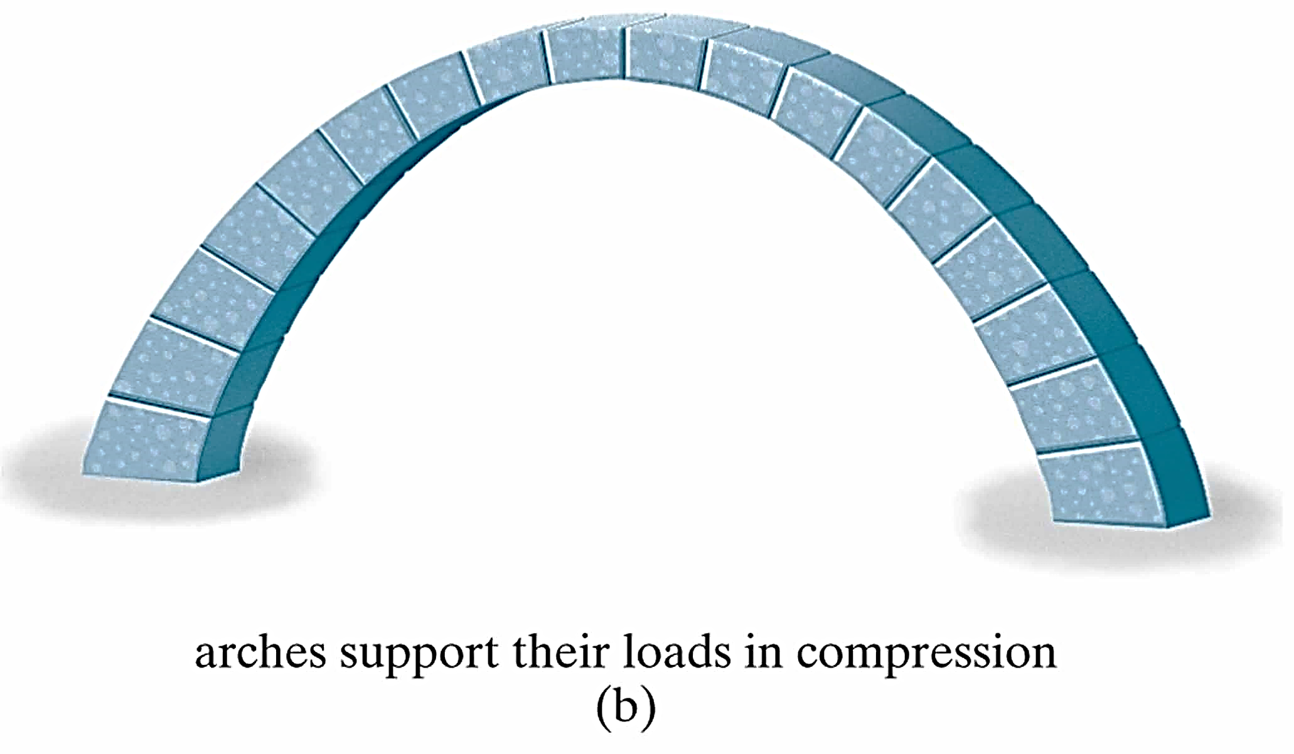
Types of Structures
Arches

Slide 13


Types of Structures

Slide 14
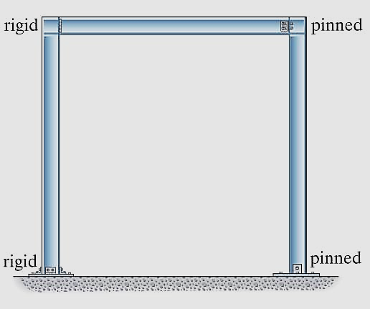
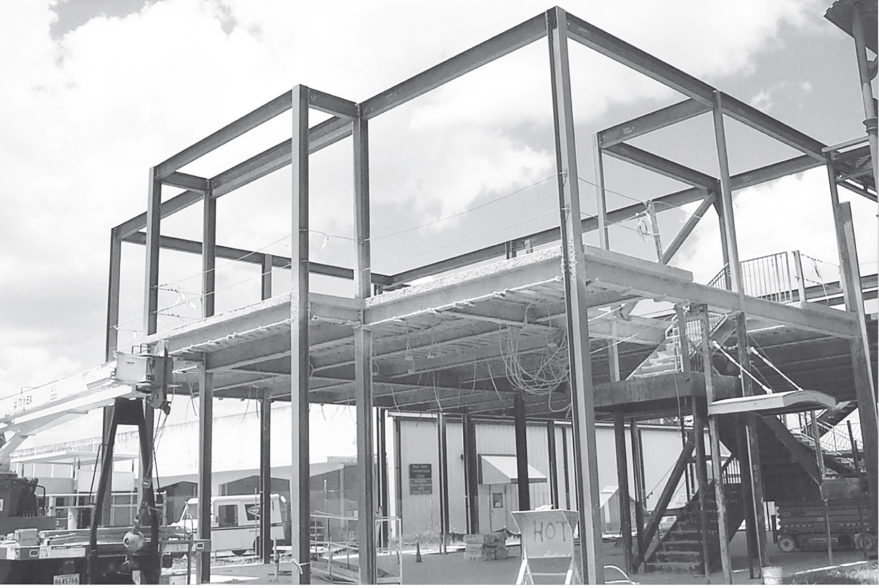
Types of Structures
Frames
Frames members are subjected to axial, shear and moment

Slide 15
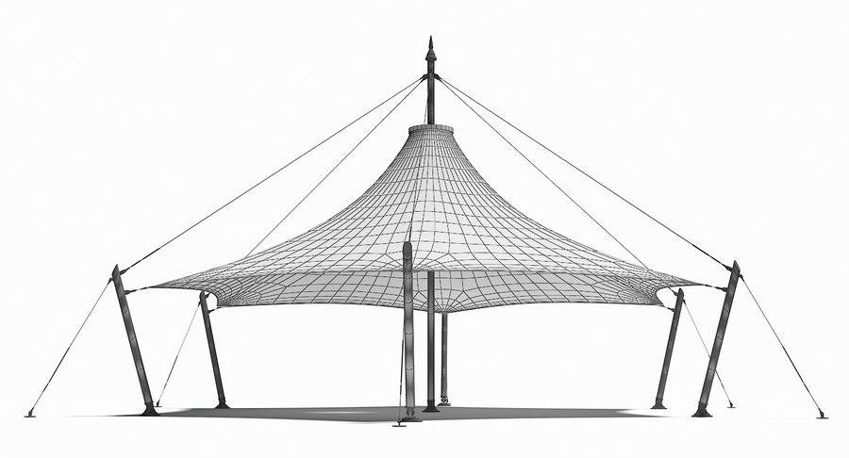
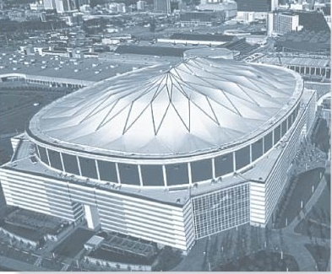

Types of Structures
Surface Structures

Slide 16
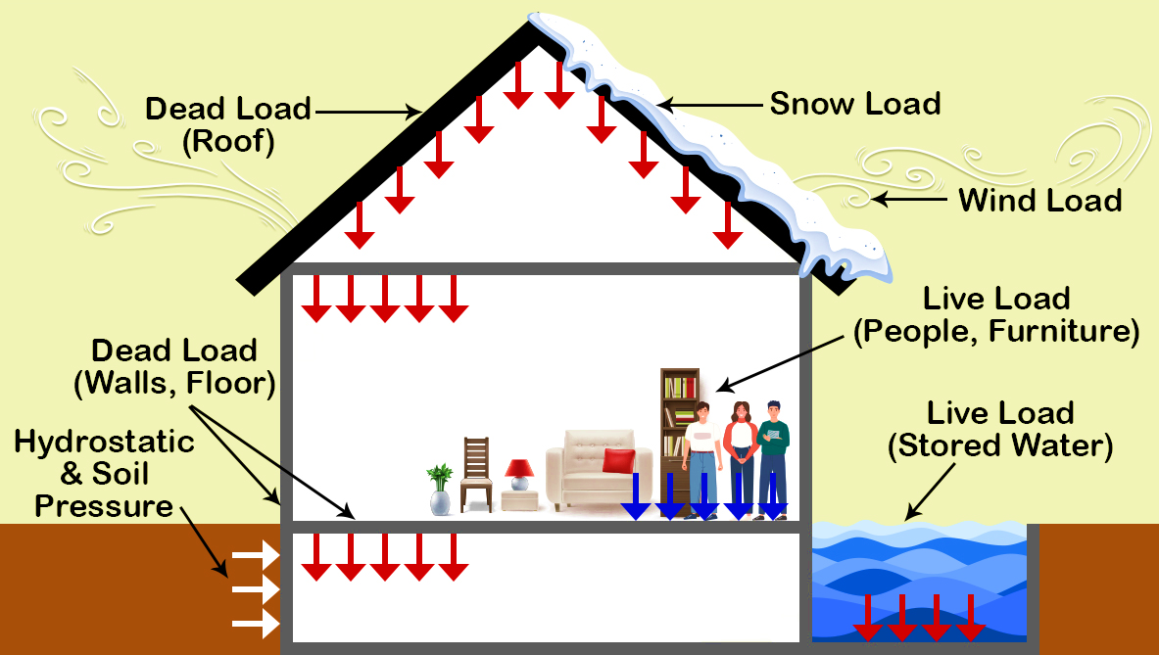
Loads
Types of load:

Slide 17
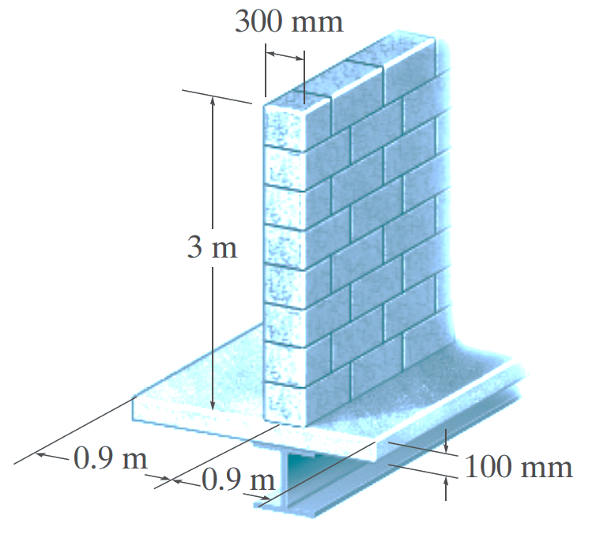
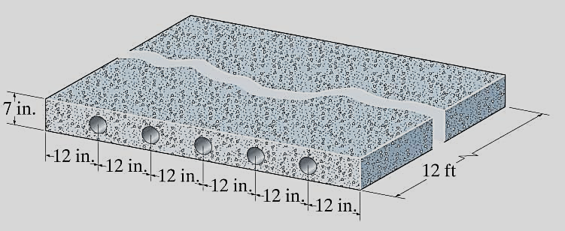
Loads
Types of load:
  Dead loads
    Weights of various structural members
    Weights of any objects that are attached to the structure

Slide 18
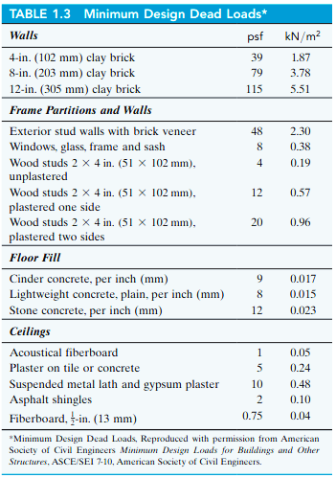

Loads

Slide 19
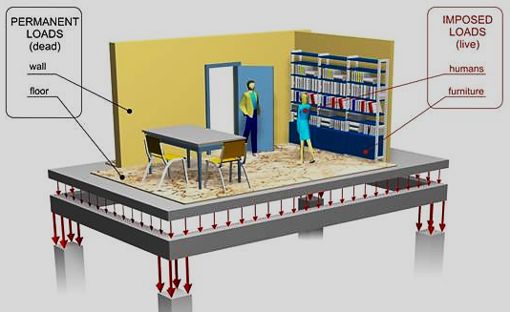
Loads

Slide 20
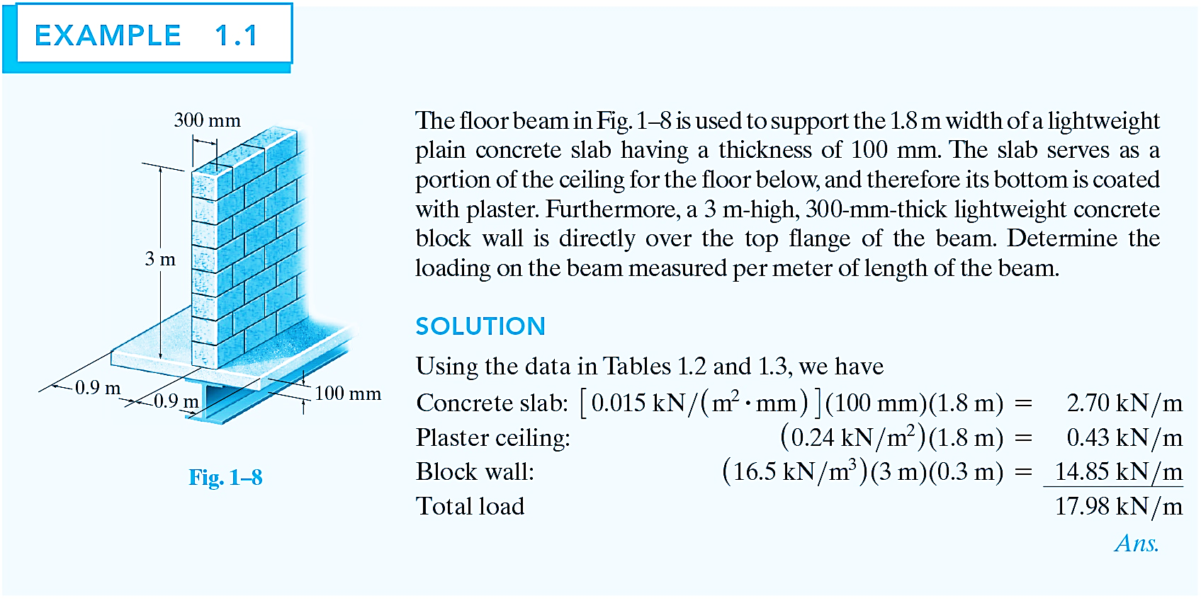
Loads

Slide 21
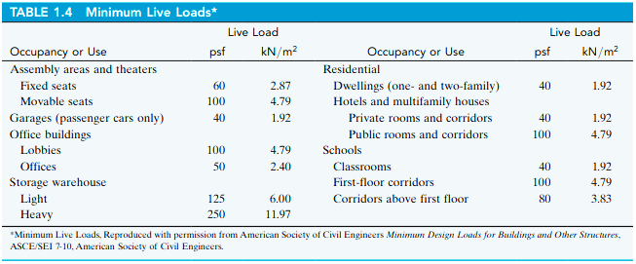
Loads
  Live loads
    Varies in magnitude & location
    Building loads
    Depends on the purpose for which the building is designed
    These loadings are generally tabulated in local, or national code

Slide 22
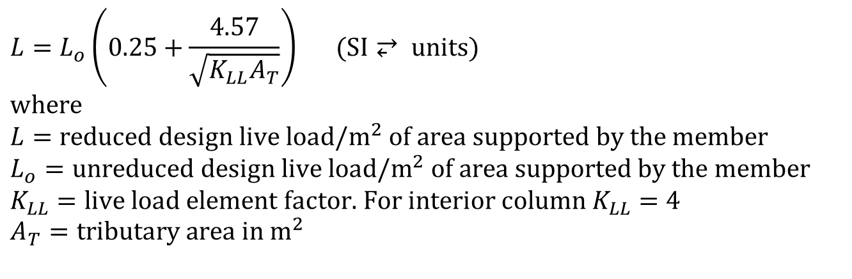
Loads
  Live loads
    Building Loads
ASCE 7-10 allows a reduction of live load on a member having an influence area (K_{LL} A_{T}) of 400 ft² (37.2 m²) or more. This reduced live load is calculated using the following equation:
$$L=L_{o}\left(0.25+\frac{4.57}{\sqrt{K_{LL}A_{T}}}\right) (\text{SI}⥂ \text{units}) \\ \text{where} \\ L=\text{reduced} \text{design} \text{live} \text{load}\text{/}{\text{m}}^{2} \text{of} \text{area} \text{supported} \text{by} \text{the} \text{member} \\ L_{o}=\text{unreduced} \text{design} \text{live} \text{load}\text{/}{\text{m}}^{2} \text{of} \text{area} \text{supported} \text{by} \text{the} \text{member} \\ K_{LL}=\text{live} \text{load} \text{element} \text{factor}\text{. }\text{For} \text{interior} \text{column} K_{LL}=4 \\ A_{T}=\text{tributary} \text{area} \text{in} {\text{m}}^{2}$$

Slide 23
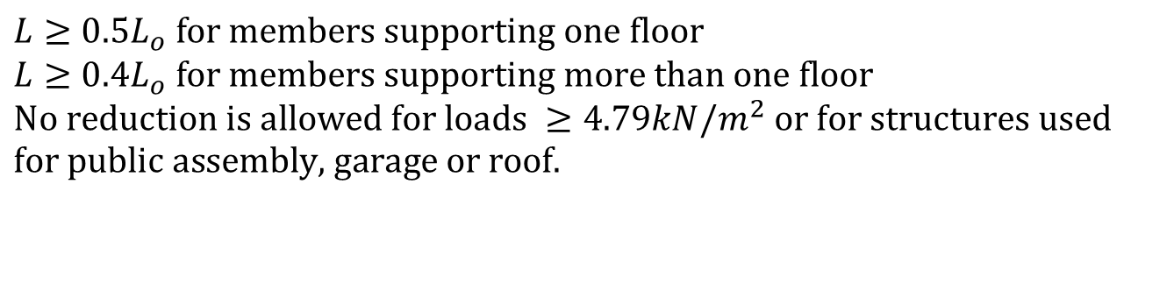
Loads
$$L≥0.5L_{o} \text{for} \text{members} \text{supporting} \text{one} \text{floor} \\ L≥0.4L_{o} \text{for} \text{members} \text{supporting} \text{more} \text{than} \text{one} \text{floor} \\ \text{No} \text{reduction} \text{is} \text{allowed} \text{for} \text{loads} ≥4.79kN/m^{2} \text{or} \text{for} \text{structures} \text{used} \\ \text{for} \text{public} \text{assembly}\text{, }\text{garage} \text{or} \text{roof}\text{.}$$

Slide 24
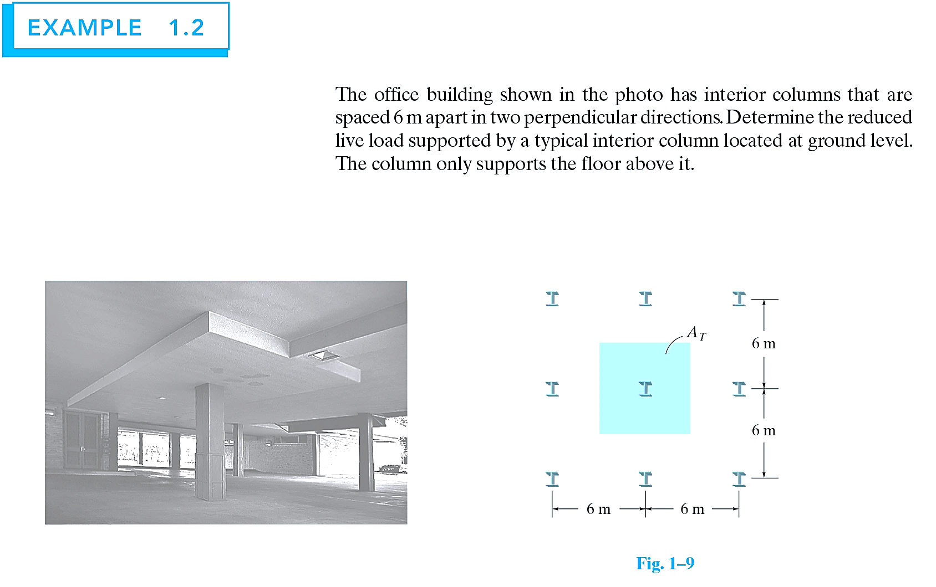
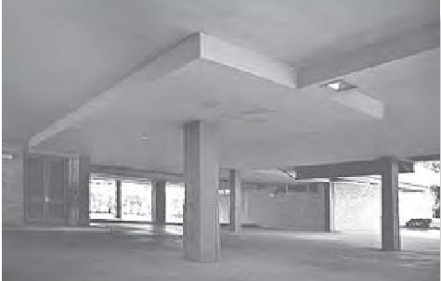
Loads

Slide 25
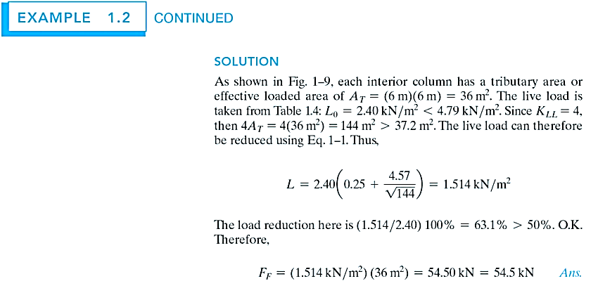
Loads

Slide 26
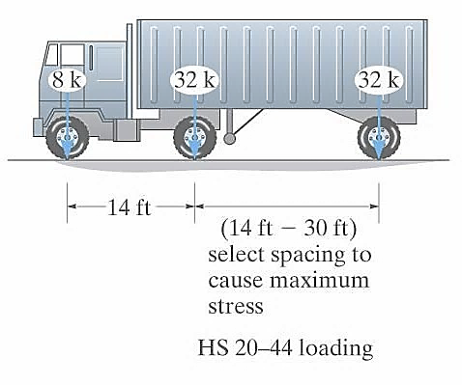
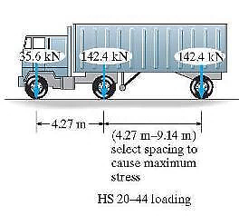
Loads
    Highway Bridge Loads
    Primary live loads are those due to traffic
    Specifications for truck loadings are reported in AASHTO

Slide 27
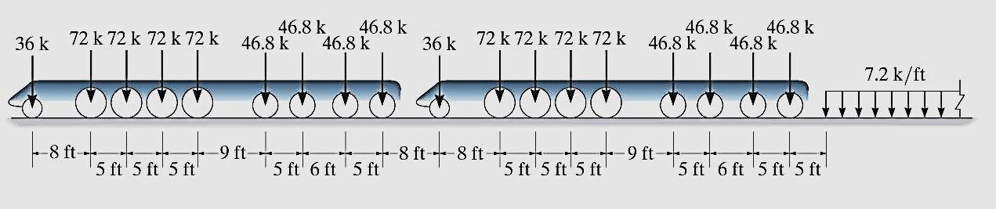
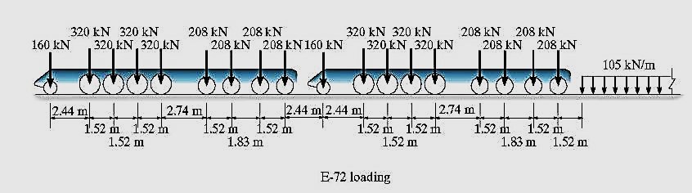
Loads
    Railroad Bridge Loads
    Loadings are specified in American Railroad Engineers Association (AREA)
    A modern train having a 320kN (72k) loading on the driving axle of the engine is designated as an E-72 loading

Slide 28
Loads
    Impact loads
    Due to moving vehicles
    The % increase of the live loads due to impact is called the impact factor, I

Slide 29
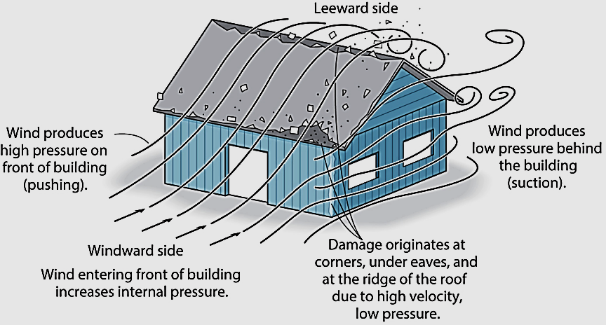
Loads
    Wind loads
    Effects of wind depends on density & flow of air, angle of incidence, shape & stiffness of the structure & roughness of surface
    For design, wind loadings can be treated as static or dynamic approach

Slide 30

Loads
    Wind loads

Slide 31
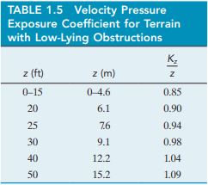
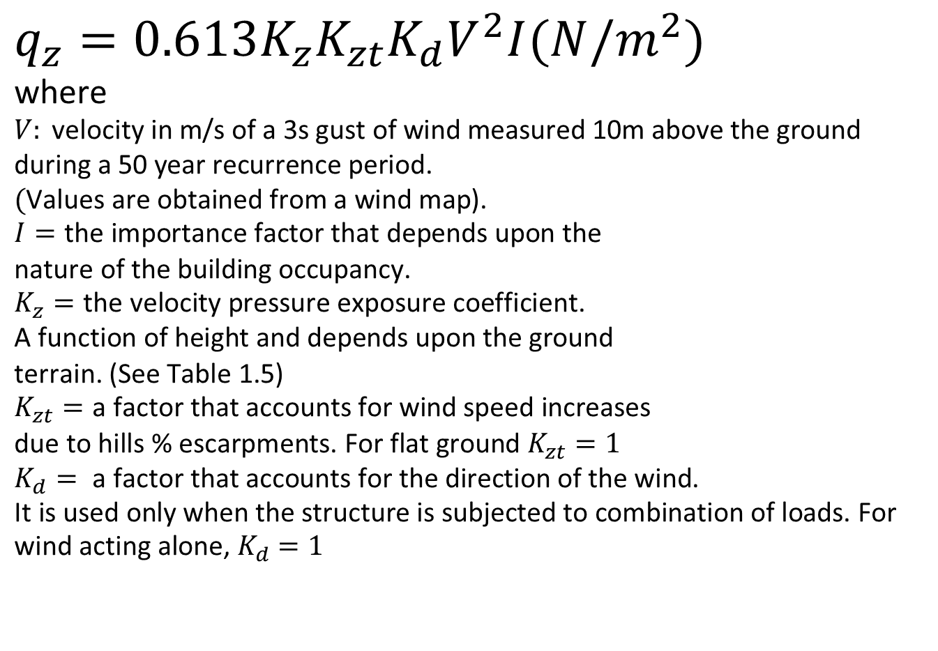
Loads
$$q_{z}=0.613K_{z}K_{zt}K_{d}V^{2}I(N/m^{2})$$
$$\text{where} \\ V: \text{velocity} \text{in} \text{m}\text{/}\text{s} \text{of} \text{a}\text{ 3}\text{s} \text{gust} \text{of} \text{wind} \text{measured}\text{ 10}\text{m} \text{above} \text{the} \text{ground} \text{during} \text{a}\text{ 50 }\text{year} \text{recurrence} \text{period}\text{. } \\ (\text{Values} \text{are} \text{obtained} \text{from} \text{a} \text{wind} \text{map}\text{)}\text{.} \\ I=\text{the} \text{importance} \text{factor} \text{that} \text{depends} \text{upon} \text{the}$$
$$\text{nature} \text{of} \text{the} \text{building} \text{occupancy}\text{. } \\ K_{z}=\text{the} \text{velocity} \text{pressure} \text{exposure} \text{coefficient}\text{. }$$
$$\text{A} \text{function} \text{of} \text{height} \text{and} \text{depends} \text{upon} \text{the} \text{ground}$$
$$\text{terrain}\text{. (}\text{See} \text{Table}\text{ 1.5)} \\ K_{zt}=\text{a} \text{factor} \text{that} \text{accounts} \text{for} \text{wind} \text{speed} \text{increases}$$
$$\text{due} \text{to} \text{hills}\text{ \% }\text{escarpments}\text{. }\text{For} \text{flat} \text{ground} K_{zt}=1 \\ K_{d}= \text{a} \text{factor} \text{that} \text{accounts} \text{for} \text{the} \text{direction} \text{of} \text{the} \text{wind}\text{. } \\ \text{It} \text{is} \text{used} \text{only} \text{when} \text{the} \text{structure} \text{is} \text{subjected} \text{to} \text{combination} \text{of} \text{loads}\text{. }\text{For} \text{wind} \text{acting} \text{alone}\text{, }K_{d}=1$$

Slide 32
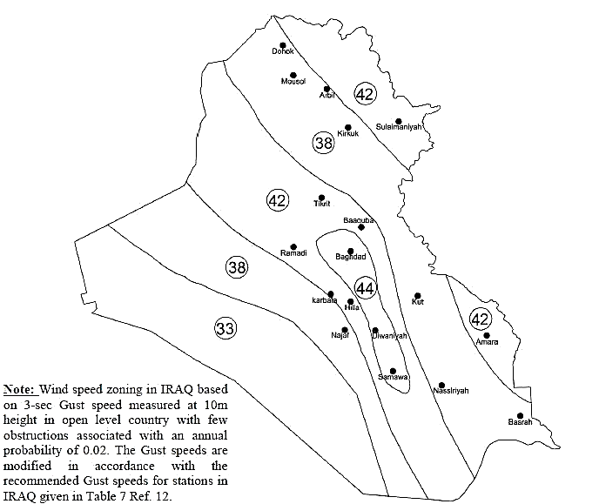
Loads
    Once q_{z} is obtained, the design pressure can be obtained from a list of relevant equations

Slide 33
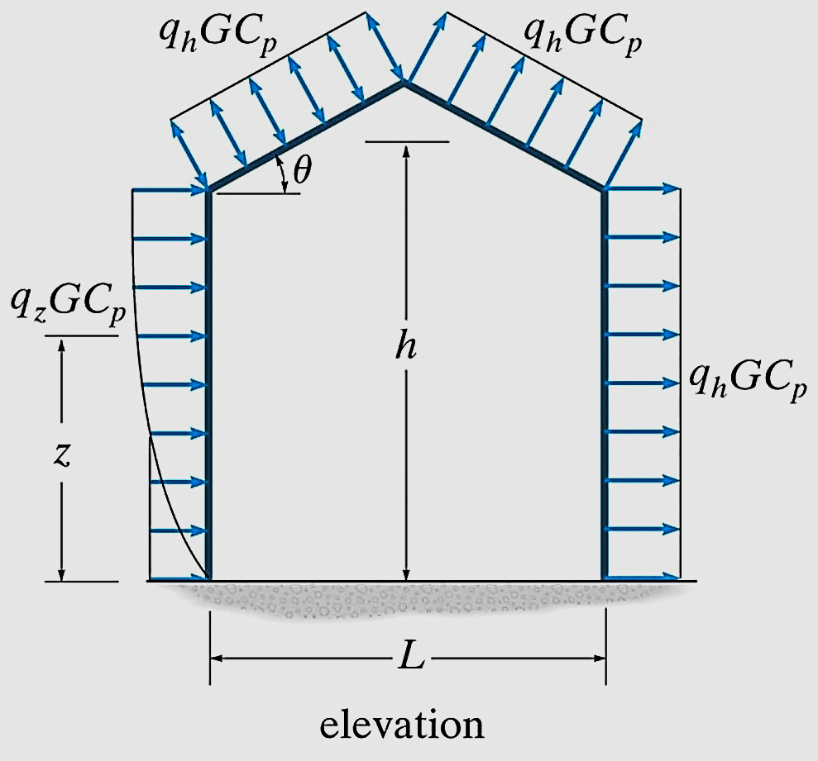
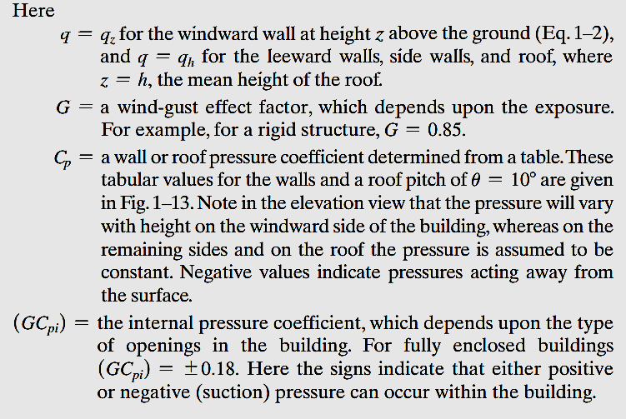
Loads
Wind Pressure for Enclosed Building
p = qGC_{p} − q_{h} (GC _{pi} ) (N/m²)

Slide 34
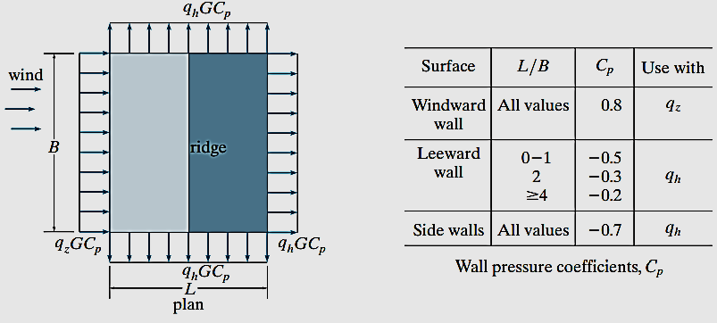
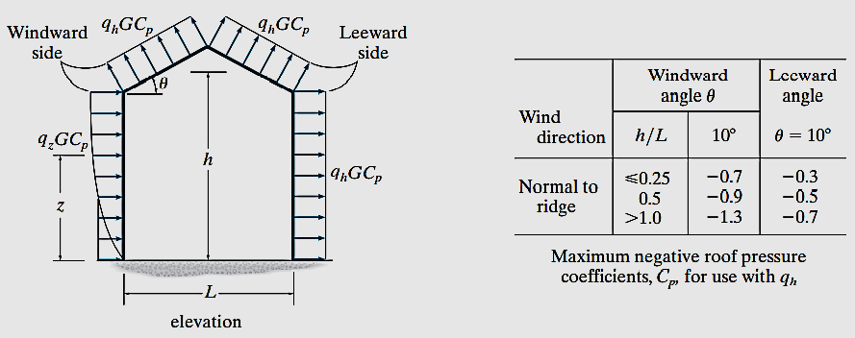
Loads

Slide 35
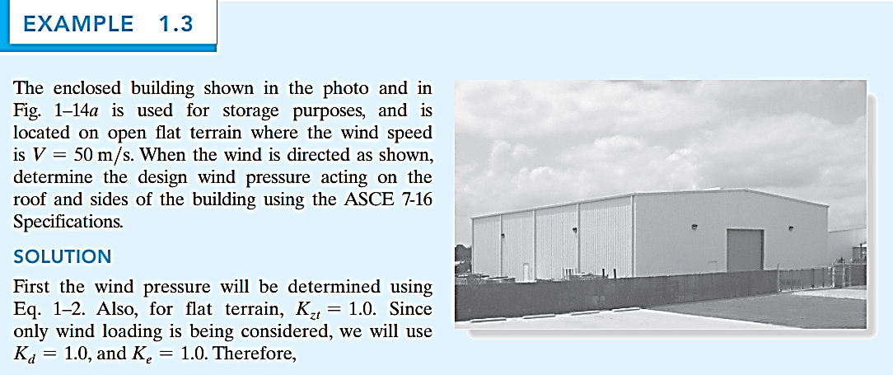

Loads

Slide 36
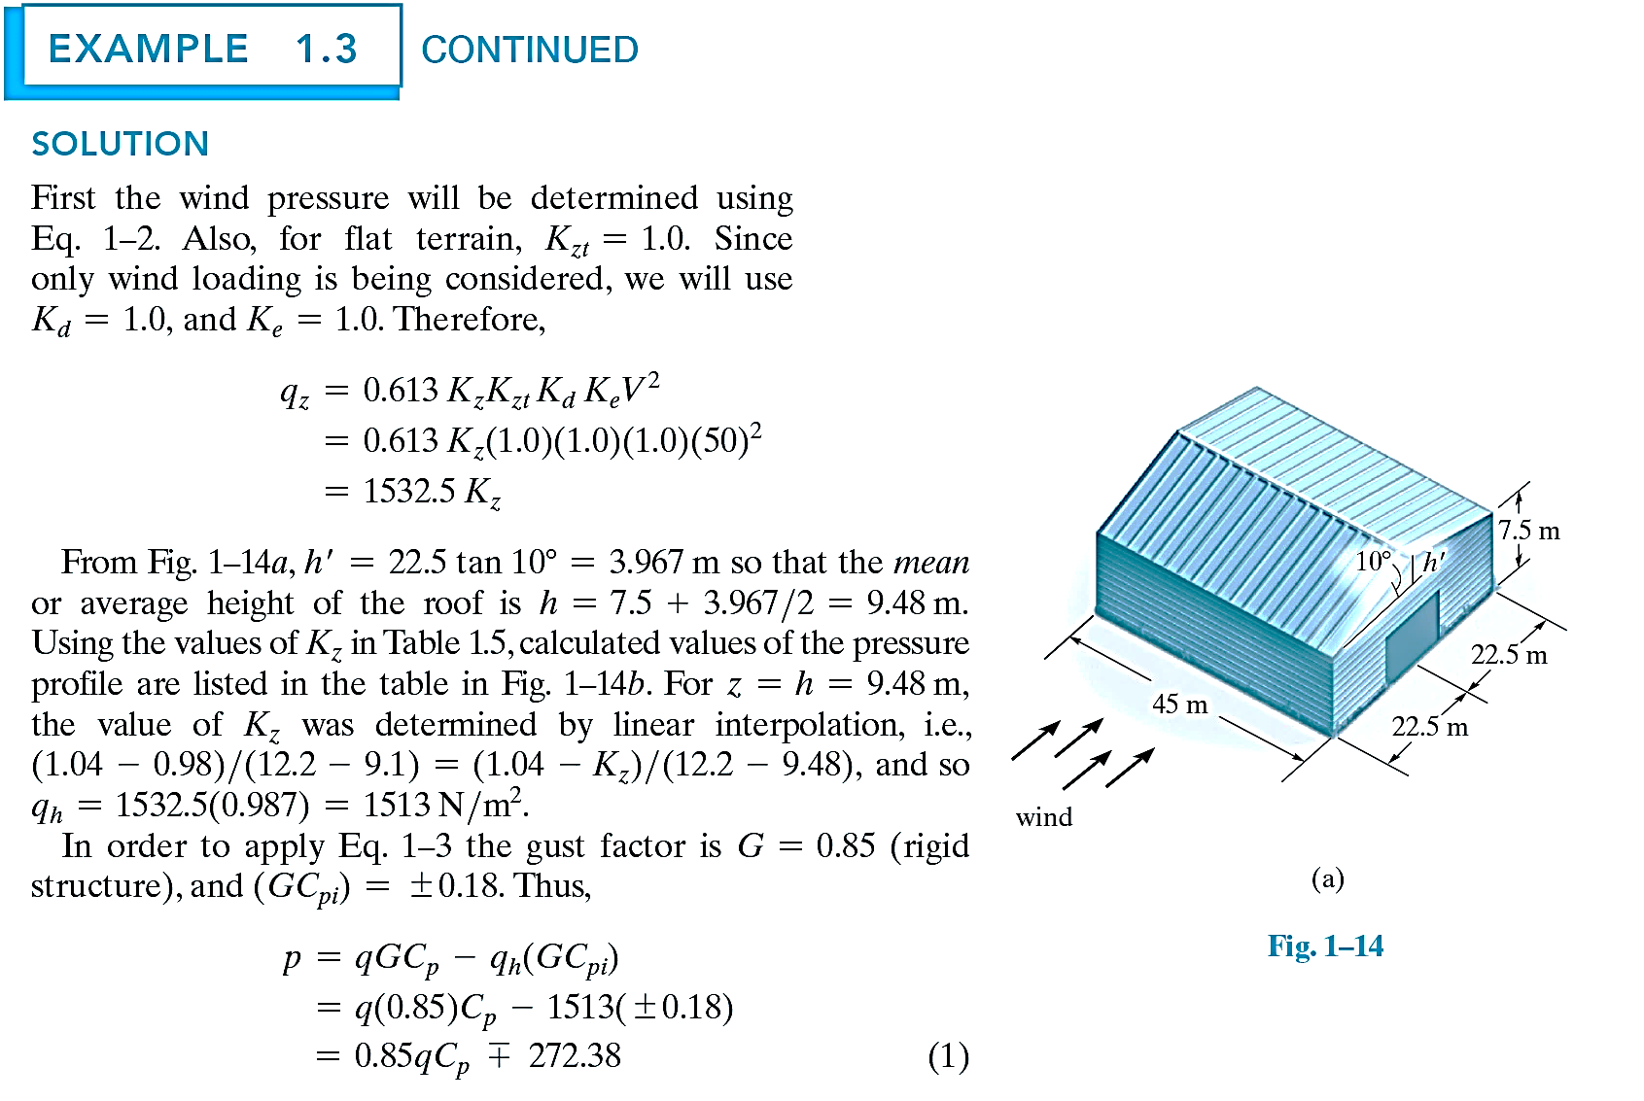
Loads

Slide 37
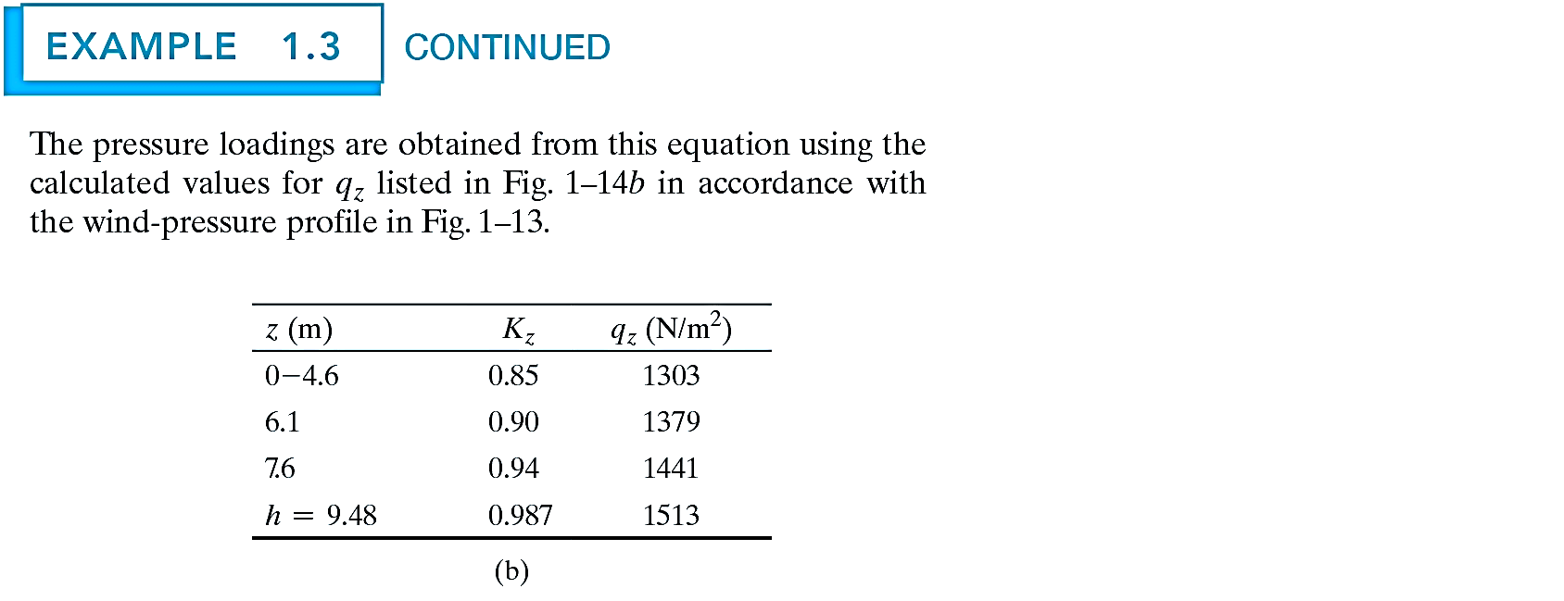
Loads

Slide 38
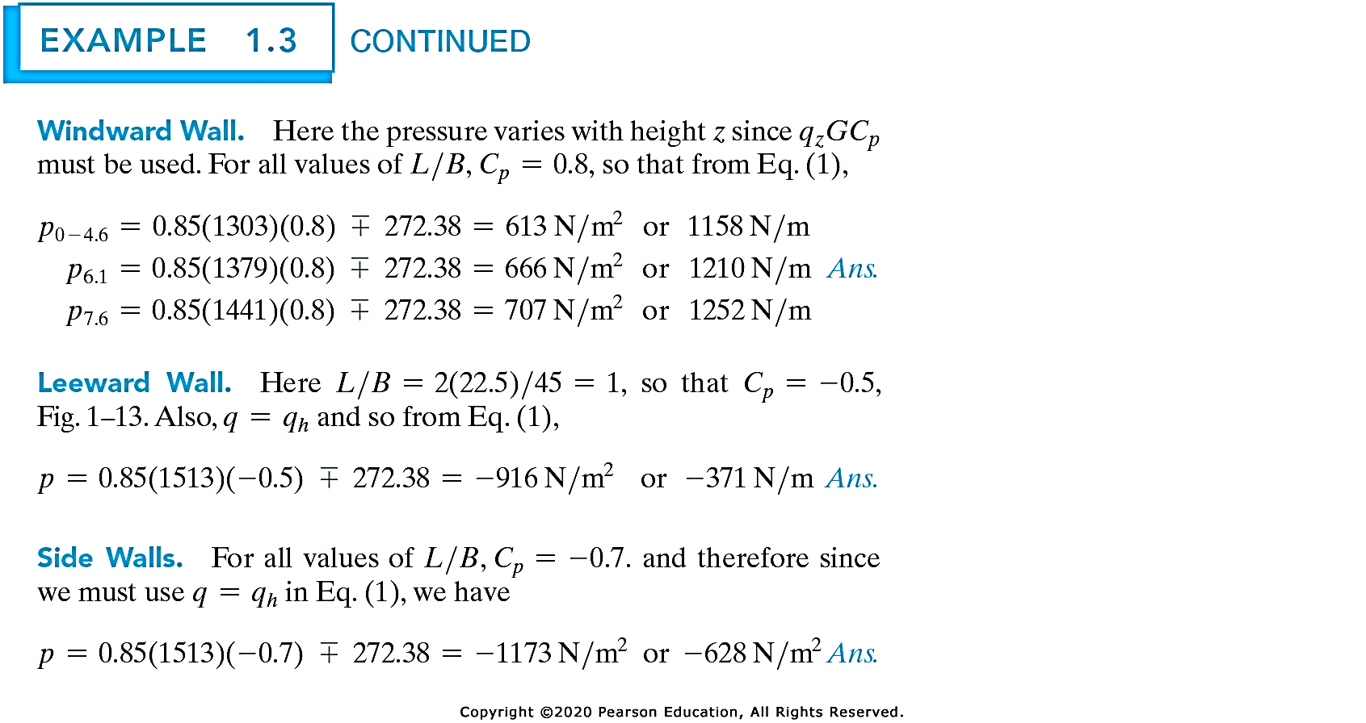
Loads

Slide 39
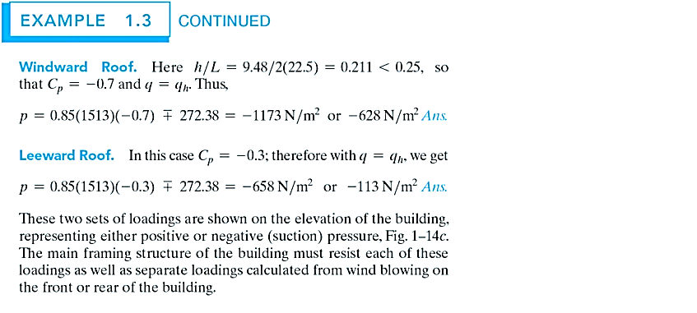
Loads

Slide 40
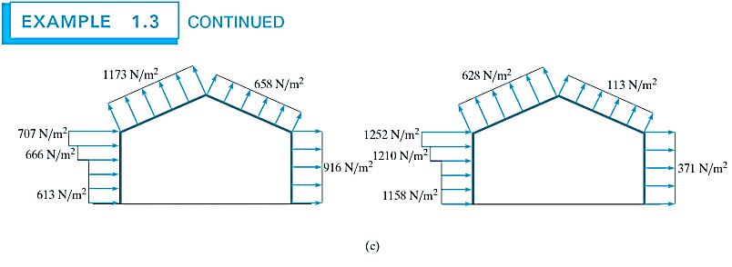
Loads

Slide 41



Loads
Design Wind Pressure for Signs F = q_{h}GC _{p} A_{f}

Slide 42

    Snow Load
Loads
If a roof is flat, having a slope of less than 5%, the pressure loading on the roof can be obtained by modifying the ground snow loading p_{g}, by the following empirical formula
p_{f} = 0.7C_{e} C_{t} I_{s} p_{g}

Slide 43
Loads
p_{f} = 0.7C_{e} C_{t} I_{s} p_{g}
C_{e} = an exposure factor which depends upon the terrain.
C_{e} = 0.8 for a fully exposed roof in an unobstructed area
C_{e} = 1.2 for roof located in the center of a large city.
C_{t} = a thermal factor, refers to the average temperature within the building
C_{t} = 1.2 for unheated structures kept below freezing,
C_{t} = 1.0 for normally heated structure.
I_{s} = the importance factor as it relates to occupancy,
I_{s} = 0.80 for agriculture and storage facilities, and
I_{s} = 1.20 for schools and hospitals

Slide 44

Loads

Slide 45

    Earthquake Load
Loads
    Horizontal accel -> shear forces in the column
    If the column is stiff & the block has a small mass, the period of vibration of the block will be short, the block will acceleration with the same motion as the ground & undergo slight relative displacements
    If the column is very flexible & the block has a large mass, induced motion will cause small accelerations of the block & large relative displacement

Slide 46
Loads
    Hydrostatic & Soil Pressure
    The pressure developed by these loadings when the structures are used to retain water or soil or granular materials
    E.g. tanks, dams, ships, bulkheads & retaining walls
    Other natural loads
    Effect of blast
    Temperature changes
    Differential settlement of foundation

Slide 47

Structural Design
    Many types of loads can occur simultaneously on a structure (All of them???)
Load combination example:

Slide 48
Structural Design
Where:
D= Dead load.
L = Live load, except roof live load.
Lr = Roof live load.
E = Earthquake load.
W= Load due to wind
F = Load due to fluids
H= Load due to lateral earth pressures
R = Rain load.
S = Snow load.
T = Load due to temperature, shrinkage, creep, differential settlement

Slide 49

Are you ready?

Slide 50
Summary
Structures and Loads: Understanding the fundamental relationship between structural components and external forces.
Structural Elements: Key elements like beams, columns, and trusses form the backbone of engineering structures.
Types of Loads: Differentiation between dead loads, live loads, and environmental effects like wind, snow, and earthquakes.
Structural Analysis: Essential methods to predict performance under various load conditions.
Design Implications: The importance of analyzing and combining loads for safe and efficient structural designs.

